Slide 1
Project TrisPrint
Affordable 3D Printed Medical Device for Trismus Treatment in Cancer Patients
ME 476C / 486C
Team Members:
Shilo Bailey, Nathan Bastidas, Cassina Olson, Carter Rhoades

Slide 2

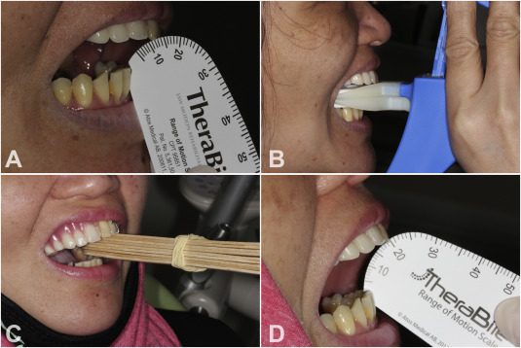
Project Description: TrisPrint Team
Primary Sponsors:
Dr. Rebecca Bartlett
Carolyn Abraham from Dignity Health
Advisors/Collaborators:
Dr. Timothy Becker
Communication Sciences and Disorder (CSD) students
Main Objective: Design an affordable medical device to increase mouth openings of clamped jaws without causing pain.
Fig. 1 - Science Direct V16 I1 doi.org
Nathan / Cassina: 1

Slide 3
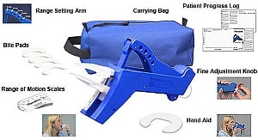
Background
Patients with Neck & Throat Cancer undergo chemoradiation therapy which can result in the muscles in the temporal mandibular joint to spasm and tighten, limiting their mouth opening.
Some patients experience extreme cases where their maximum mouth opening (MMO) is limited to 0-20mm
Current treatment devices are available but can cost $500+ (with and without insurance) and cause the patient enough discomfort (or injury) to discontinue physical therapy.
Fig. 1 - Science Direct V16 I1 doi.org
Fig 2 - Therabite
Cassina: 2

Slide 4
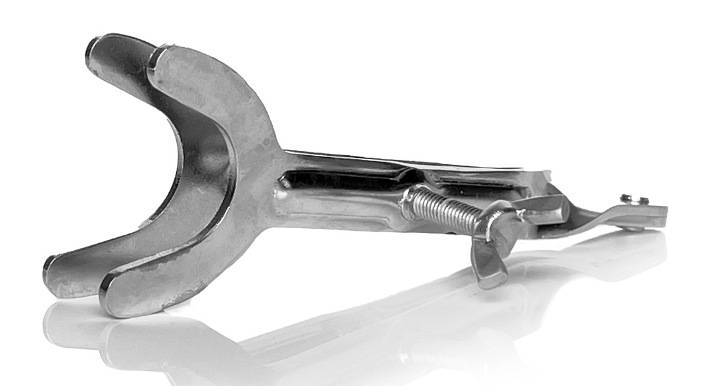
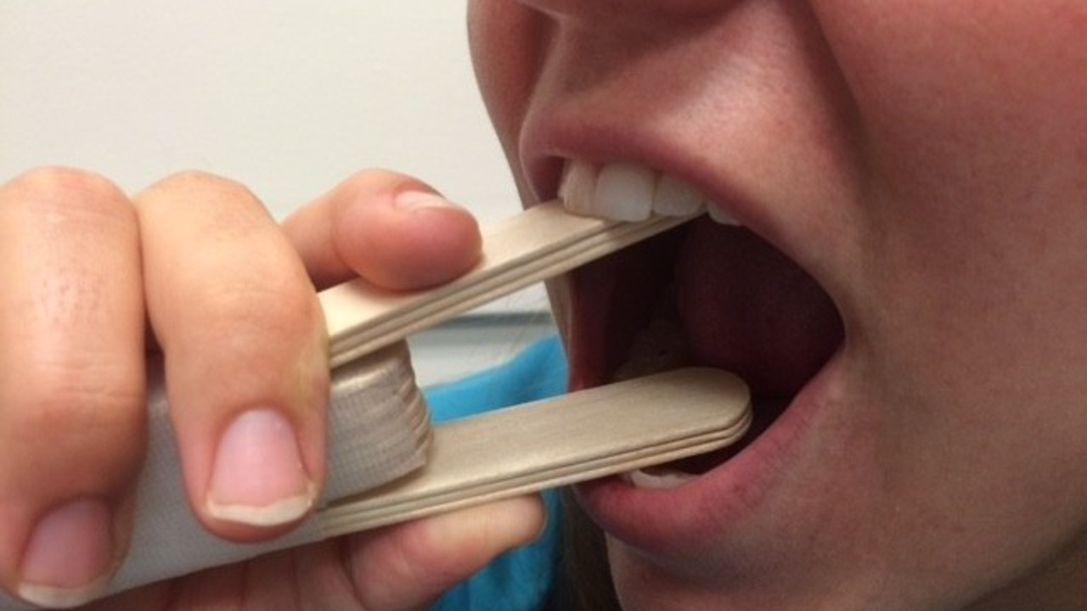
Benchmarking
Benchmarking
TheraBite: $579.99
Adjustable with replacement bite pads
UNIQUE: $24
Extremely painful but more affordable
In house Trismus Device
Non-reusable but low cost
Created by clinician
Fig 2 - Therabite
Fig 4 - UNIQUE Trismus
Fig 3 - In-house Trismus
Cassina: 3

Slide 5
Design Requirements:
Customer Requirements
Customer Requirements | Description
Fully 3D Printable and Open Source | Client has requested that the device is able to be fully 3D printed with detailed instructions and clear disclaimers towards what materials and printing tolerances are required for the device.
Medically Safe For User | The device must be made entirely out of FDA / ISO compliant materials that, during normal operation, should not cause any short- or long-term damage to the patient.
<$50 Per Unit | The total cost of printing material required to print the device must be under $50.
Ability to Measure Progress | To aid researchers and clinicians, the device should be able to measure out muscle displacement as well as applied force to the jaw so that progress can be measured over time.
Table I: Customer Requirements for Design
Shilo: 4

Slide 6
Design Requirements:
Engineering Requirements
Engineering Requirements | Description | Units
Quick Printing Speed | With a current assembly print time of ~17 hours, the team wishes to reduce this time to allow for faster production. | Hrs
Durable and Flexible | By determining our tolerance range in terms of elastic and tensile strength, we can ensure the device can bend and move without breaking during operation. | MPa
Easily Reproducible | By refining the CAD model, as well as the instruction suite and print settings, the device should be able to be reproducible with limited need for modification of the model or printer being used. | N/A
Measurement System | The device should be able to measure out incisor displacement (in mm/in) and applied force to jaw (in N/lbs) | (mm), (N)
Table II: Engineering Requirements for Design
Nathan: 5

Slide 7
Design Requirements:
Correlations
Customer Requirements | Correlation | Engineering Requirements
Fully 3D Printable | To ensure easy and quick replication, both speed and a one-print setup is key to developing an easy access Trismus device. | Quick Printing Speed
Medically Safe For User | By ensuring parts of the device won't break during operation, as well as the general safety of the material, our device will be safer than most homemade solutions. | Durable and Flexible
<$50 Per Unit | By focusing on a low cost per unit, we can ensure that this device is easily producible in mass quantities by clinics and can be afforded by a variety of patients. | Easily Reproducible
Ability to Measure Progress | With a built-in measurement system, clinicians and researchers can track a patient's progress over time and be able to note displacement and applied force. | Measurement System
Table III: Design Requirements Correlations
Carter: 6

Slide 8
Literature Review: pt 1 (Shilo)
[1] Nina Pauli, Ulrika Svensson, Therese Karlsson & Caterina Finizia (2016) “Exercise intervention for the treatment of trismus in head and neck cancer – a prospective two-year follow-up study,” Acta Oncologica, 55:6, 686-692, DOI: 10.3109/0284186X.2015.1133928
  A study investigated if structured exercises with jaw mobilizing devices would improve mouth opening and quality of life in head and neck cancer patients who experience limited jaw opening (trismus) as a side effect of radiotherapy. Patients who exercised showed significantly better improvement in mouth opening and reported fewer trismus-related symptoms and better overall quality of life after two years compared to a control group, suggesting this exercise program to be an effective long-term treatment for trismus in these patients.
[2] Charters E, Dunn M, Cheng K, Aung V, Mukherjee P, Froggatt C, Dusseldorp JR, Clark JR, “Trismus therapy devices: A systematic review,” Oral Oncology, Volume 126, 2022, 105728, ISSN 1368-8375, https://doi.org/10.1016/j.oraloncology.2022.105728.
  A two-year study showed that head and neck cancer patients who did structured exercises with jaw mobilizing devices after radiation treatment had significantly better long-term jaw opening and fewer symptoms like trouble eating and speaking compared to patients who didn't exercise. This suggests these exercises can be a valuable treatment for radiation-induced jaw limitations, improving patients' quality of life.
[3] Daniel Buchbinder, Robert B. Currivan, Andrew J. Kaplan, Mark L. Urken, “Mobilization regimens for the prevention of jaw hypomobility in the radiated patient: A comparison of three techniques,” Journal of Oral and Maxillofacial Surgery, Volume 51, Issue 8, 1993, Pages 863-867, ISSN 0278-2391, https://doi.org/10.1016/S0278-2391(10)80104-1.
  Researchers compared jaw exercises with tongue depressors or a Therabite device to improve jaw mobility in radiated head and neck cancer patients. After ten weeks, the Therabite group showed significantly greater improvement and continued to gain mobility throughout the study, while the other groups plateaued after four weeks. Patients using Therabite also reported feeling more in control and compliant with the exercises, suggesting it may be a more effective treatment for radiation-induced jaw limitations.
[4] Emma Charters, Jamie Loy, Raymond Wu, Kai Cheng, Masako Dunn, Sarah Davies, Jonathan Clark, “Feasibility study of intensive intervention using novel trismus device during adjuvant radiation for head and neck cancer: RestorabiteTM,” Oral Oncology, Volume 146, 2023, 106558, ISSN 1368-8375, https://doi.org/10.1016/j.oraloncology.2023.106558. ‌
  This pilot study investigated a new 3D-printed jaw stretching device called RestorabiteTM for patients with head and neck cancer who experience limited jaw opening (trismus) after surgery and before radiation therapy. The device applies a regulated force to improve jaw mobility and patients were followed for 6 months. The study showed good patient adherence, significant improvement in jaw opening, and improved quality of life. Future studies will explore improving adherence during radiation and determine the optimal force for individual patients.
Shilo: 7

Slide 9
Literature Review: pt 2 (Nathan)
[6] J. B. Park and R. S. Lakes, Biomaterials: An Introduction. New York, NY: Springer, 2010.
  This textbook focuses on the biocompatibility of various materials, degradation and science. The source focuses on the major materials (ceramics, metals, and polymers) in a biomedical context, highlighting the various uses of these different materials and their strengths and weaknesses in their application. For this project, the chapters focusing on polymers are the most important, as many 3D printing filaments are considered polymers of some kind.
[7] D. Dharavath and R. Maddi, “ISO standards of Medical Devices,” World Journal of Current Medical and Pharmaceutical Research, https://wjcmpr.com/index.php/journal/article/view/213
  The medical article displays the various categories of the ISO safety standards and how biomedical devices are classified under such a system. These safety standards give our team clear insight into how meticulous we must be when designing this product to have a device that will not cause any harm or biological damage to the patient.
[8] M. Jeong et al., “Materials and applications of 3D printing technology in Dentistry: An overview,” MDPI, https://www.mdpi.com/2304-6767/12/1/1
  This document highlights the current state of 3D printing with regards to dental procedures and products. As our device deals with the inside of the human mouth, some details regarding the landscape of 3D printing with regards to the mouth could help provide some examples of different compatible materials to use.
[9] “Biocompatible 3D resins for medical devices,” 3Dresyns, https://www.3dresyns.com/pages/bio-compatible-3dresyns
  This document gives us additional references regarding different 3D printing material that is considered biocompatible. However, this article focuses more on biocompatible resins rather than more common type known as filaments
Nathan: 8

Slide 10
Literature Review: pt 3 (Cassina)
[10] J. P. Davim, The design and manufacture of medical devices. Ch 1. Cambridge: Woodhead Publishing Ltd, 2012.
  This book chapter cites a few commonly used biomedical materials and their biocompatibility in humans as tested. It further explains the qualities that constitute a biomedical device versus a device interacted with by humans regularly and where people may posit to draw a line between them. It references the FDA for device classification and uses these guidelines as a basis for class 2 and class 3 medical devices.
[11] Center for Devices and Radiological Health, “Classify Your Medical Device,” U.S. Food and Drug Administration, Jul. 02, 2020. https://www.fda.gov/medical-devices/overview-device-regulation/classify-your-medical-device
  This FDA source provides the specific qualities and requirements for a medical device to be classified as class 1, 2, or 3. This source defines class 1 devices as noninvasive, non-surgical, temporary, and containing no bioactive components. Under this system, the trismus device is considered a class 1 device alongside Band-Aids and gauze wrappings.
‌[15] P. U. Dijkstra, W. W. I. Kalk, and J. L. N. Roodenburg, “Trismus in head and neck oncology: a systematic review,” Oral Oncology, vol. 40, no. 9, pp. 879–889, Oct. 2004, doi: https://doi.org/10.1016/j.oraloncology.2004.04.003.
  This paper shows the effects of radiation on certain muscle groups and joints in the mandibular area. It continues to express the strains within the mouth and how to combat muscle strain and varying upper neck muscle losses from radiation.
[16] C.-J. Wang, E.-Y. Huang, H.-C. Hsu, H.-C. Chen, F.-M. Fang, and C.-Y. Hsiung, “The Degree and Time-Course Assessment of Radiation-Induced Trismus Occurring After Radiotherapy for Nasopharyngeal Cancer,” The Laryngoscope, vol. 115, no. 8, pp. 1458–1460, Aug. 2005, doi: https://doi.org/10.1097/01.mlg.0000171019.80351.46.
  This book chapter analyzes the severity of trismus after different times in which the patient was exposed to radiation therapy and whether surgery was involved/required for the cancer cells/tumor. It further explored the possibility of beginning trismus treatment early and the effects of this on keeping patients from ever experiencing trismus symptoms that limit opening to under 6mm (about 0.24 in).
Cassina: 9

Slide 11
Literature Review: pt 4 (Carter)
[17] J. Lee and A. Huang, “Fatigue Analysis of FDM Materials,” Rapid Prototyping Journal, vol. 19, no. 4, pp. 291–299, Jun. 2013. doi:10.1108/13552541311323290
This source provides an overview of fatigue in 3D printed materials. The information in this article is useful because it helps us determine how long each part might last, as well as some considerations to lessen the effect of fatigue on 3D printed objects.
[18] C. Guttridge, A. Shannon, A. O’Sullivan, K. J. O’Sullivan, and L. W. O’Sullivan, “Biocompatible 3D printing resins for medical applications: A review of marketed intended use, biocompatibility certification, and post-processing guidance,” Annals of 3D Printed Medicine, vol. 5, p. 100044, Mar. 2022. doi:10.1016/j.stlm.2021.100044
This source provides an overview of a biocompatible variant of SLA resin, its uses, and how to process parts out of the printing area. This may prove useful for our project if we require the use of SLA printed mouthpieces that conform to a scan of the patient's mouth.
[19] L. Novakova-Marcincinova, J. Novak-Marcincin, J. Barna, and J. Torok, “Special materials used in FDM Rapid Prototyping Technology Application,” 2012 IEEE 16th International Conference on Intelligent Engineering Systems (INES), Jun. 2012. doi:10.1109/ines.2012.6249805
This Source provides an overview of various specialty or uncommon 3D printer materials. Some materials may be stronger than others but significantly harder to print, this source explains the various tradeoffs between various filaments.
Carter: 10

Slide 12
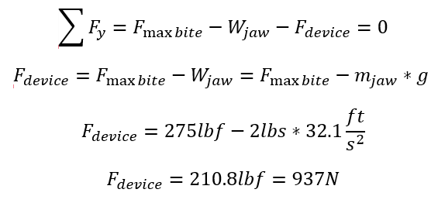
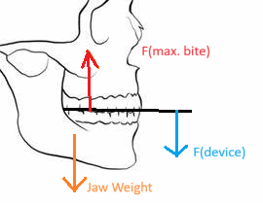

Mathematical Modeling - Muscle
Assumptions:
Maximum 'bite' force is "produced at horizontal and vertical joint force directions", [20].
Temporomandibular Joint is a simple lever model
Average Jaw Weight:
  Head Wt = 10 – 11lbs [21]
  Jaw is approx. 20% of head weight/mass
  Assumed Jaw Wt = 2lbs
Maximum Bite Force: F = 275lbf or 1.22kN [22]
For patients with 0mm of mouth opening, the jaw would be static.
Equations
Static Equilibrium -
[20] T.M.G.J. van Eijden, E.M. Klok, W.A. Weijs, J.H. Koolstra, "Mechanical capabilities of the human jaw muscles studied with a mathematical model, Archives of Oral Biology," Volume 33, Issue 11, 1988, Pages 819-826, ISSN 0003-9969, https://doi.org/10.1016/0003-9969(88)90106-9. (accessed Feb. 4, 2024)
[21] “How Much Does the Human Head Weigh? (Answered) | Measuringly,” Aug. 10, 2023. https://measuringly.com/how-much-does-human-head-weigh/
[22] E. D. Excellence, “How Powerful Is the Jaw? | How Jaw Pain Can Affect Oral Health,” Eastgate Dental Excellence, Jan. 31, 2022. https://eastgatedentalexcellence.com/blog/the-human-jaw-and-how-it-affects-your-oral-health/ (accessed Feb. 4, 2024).
Fig 5 – Jaw Bite Forces
Shilo: 11

Slide 13
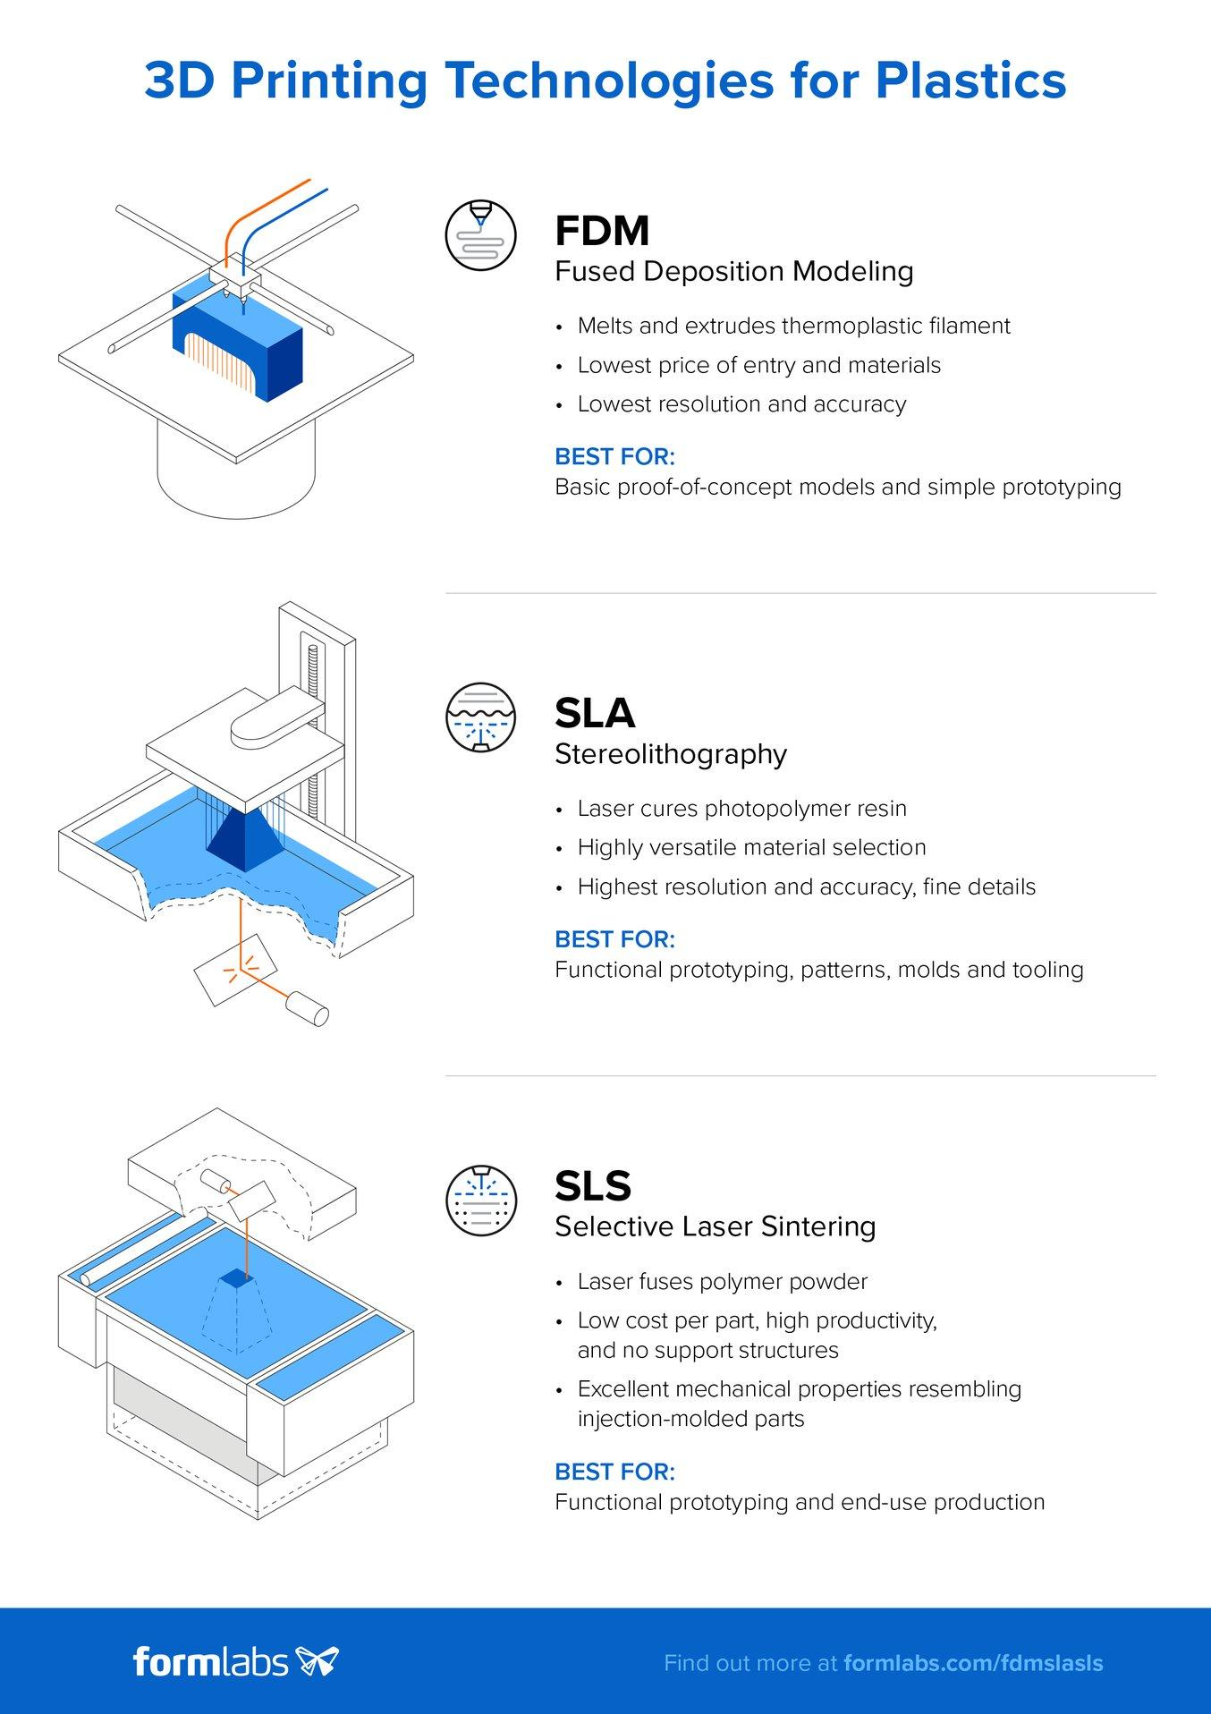
Mathematical Modeling – Manufacturing
Equations, Engineering Tools
3D Printer Slicers (Chitubox, Cura, Ideamaker)
3D Printing Equation (General)
  Max Speed_{Rec.} = (Flow Rate_{Max}) / (Height_{Layer} * Extrusion Width)
Flow Rate Equation:
  Flow Rate = Nozzle Size (mm) x (Height_{Layer} * Print Speed)
Example:
Max Speed_{Rec.} = (13 mm^3/s) / (0.2 mm * 0.6 mm)
Max Speed_{Rec.} = 108 mm/s
Fig 6 – SLA Printing
Fig 7 – FDM Printing
Nathan: 12

Slide 14
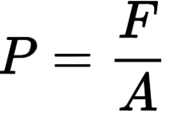

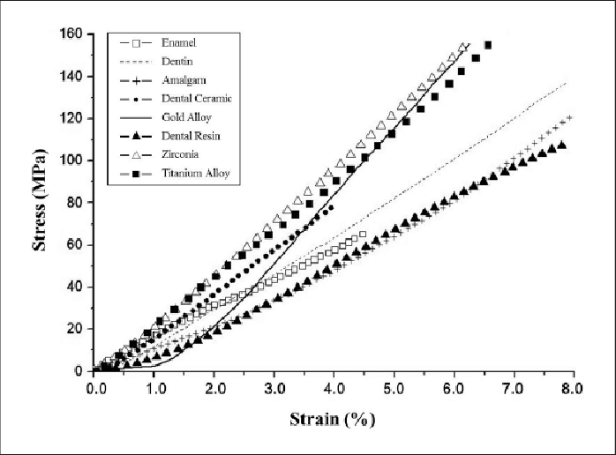
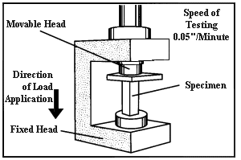
Mathematical Modeling - Dental
Equations
Pressure and Tooth Fracture Propagation
2. Engineering Tools
Compression force testers, Radial compression force testers, Online pressure simulator
3. Example (No Teeth vs Teeth)
Max Pressure from source: 44.6 –74.4 Kg/m^2.
F = 230 – 251 N
L = 16.44cm--19.33cm W = 0.71cm--1.10cm
A = 11.67cm^2—21.26cm^2
P = 197 kPa – 108 kPa
Fig 8 – Compression Test Machine
[23] C. E. Anyanechi and B. D. Saheeb, “Mandibular sites prone to fracture: analysis of 174 cases in a Nigerian tertiary hospital,” Ghana medical journal, vol. 45, no. 3, pp. 111–4, 2011. https://www.ncbi.nlm.nih.gov/pmc/articles/PMC3266144/#:~:text=Functional%20processes%20such%20as%20the
[24] Chun, Keyoung & Lee, Jong. (2014). Comparative study of mechanical properties of dental restorative materials and dental hard tissues in compressive loads. Journal of dental biomechanics.
[25] MatWeb, “Compressive Strength Testing of Plastics,” www.matweb.com. https://www.matweb.com/reference/compressivestrength.aspx
Fig 9 – Dental Restorative Stress-Strain Graph
Cassina: 13

Slide 15
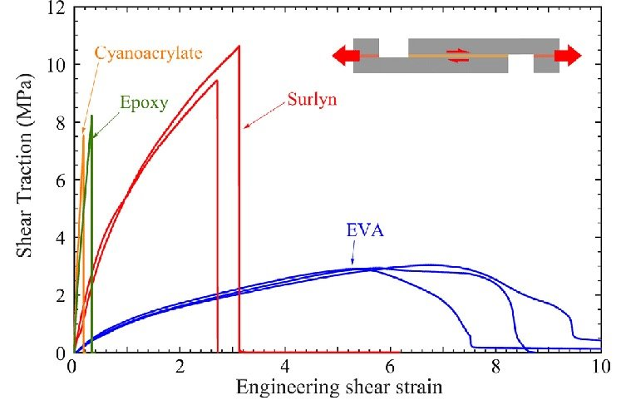
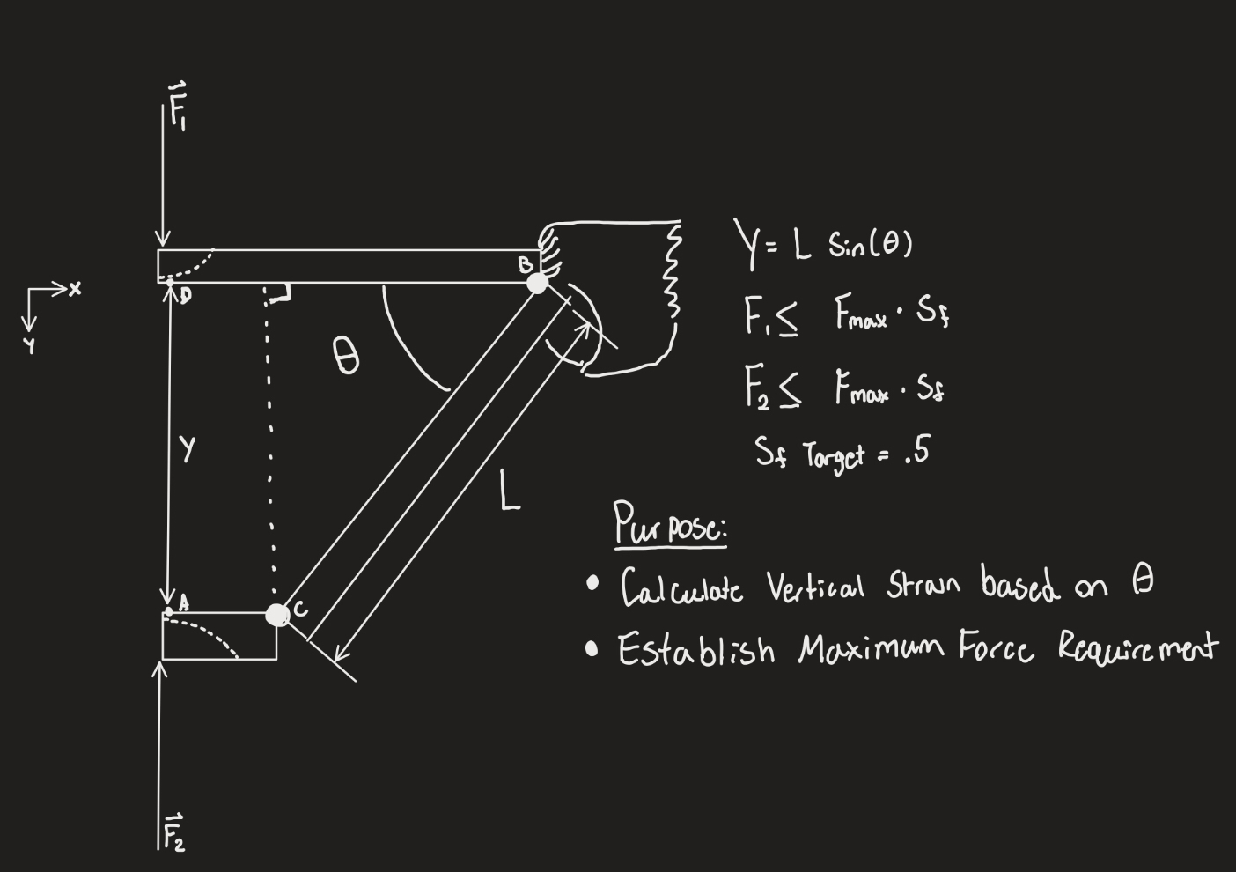
Mathematical Modeling - Lever Properties
Relevant Variables:
Y= Vertical Displacement
Θ = Lever Angle
L = Lever Length
F₁= Force Applied to top Teeth
F₂ = Force Applied to Bottom Teeth
Mb= Moment of point B (Fulcrum)
Fig. 10 – Strain Graph of Polymers
Example Shear-Strain:
Shear-strain graphs will be used after forces are calculated to select appropriate materials.
Relevant Equations:
① Y=L*Sin(Θ)
② Mb = F₂*(L*Cos(Θ))
③ ΣFx = 0 (Device Stays Fixed)
④ΣFy = 0 (Device Stays Fixed)
Engineering Tools:
MatLab analysis Algorithm
Stress-Strain Measurement Device
Force Analysis Equipment
Fig. 9 - Model Of Potential Device
Carter: 14

Slide 16
Black Box Model
Inputs:
Mechanical Energy (Hand Motion)
Compressive and Tension Force (Jaw Muscles)
Function:
Help Stretch Jaw Muscles passively and actively through different stretching exercises
Outputs:
Tension Stress (Jaw Muscle)
Mechanical Energy (From Device)
Numerical Data (Muscle Displacement and Force Output)
Fig. 11 - Black Box Model
Shilo: 15

Slide 17
Functional Decomposition
Trismus Treatment Device
Stretch Jaw Muscles Open (min. 10 mm)
Allow for active stretching exercises (chewing, etc.)
Measure Stretch Distance and Force Output
3-D Printable CAD Model
Fig. 12 – Functional Decomposition
Shilo: 16

Slide 18
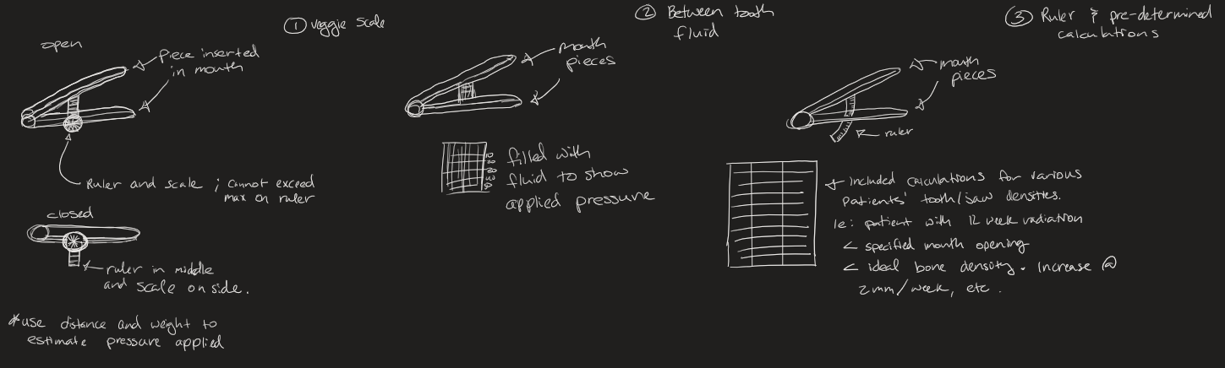
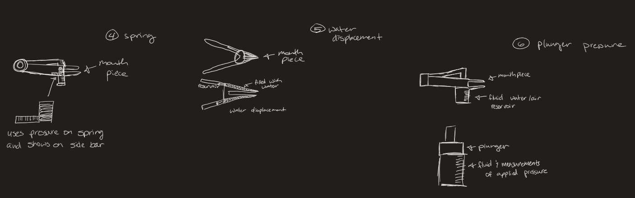
Concept Generation:
Pressure Measurement
Fig. 13 – Pressure Measurement Systems
Cassina: 17

Slide 19
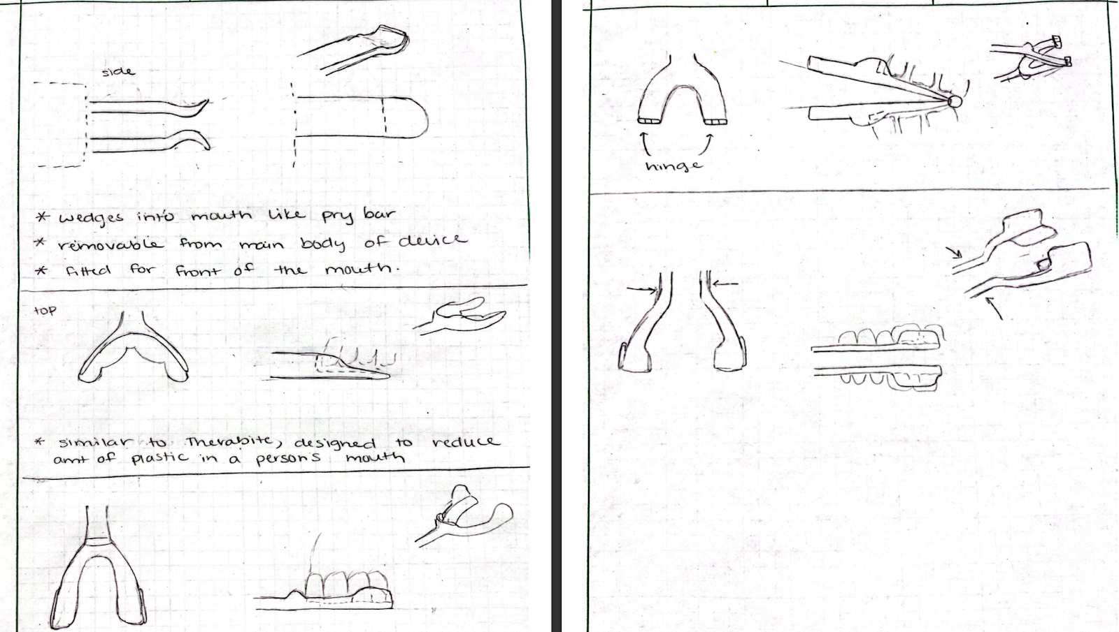
Concept Generation:
Mouth Pieces
Fig. 14 – Mouthguards Designs
Shilo: 18

Slide 20
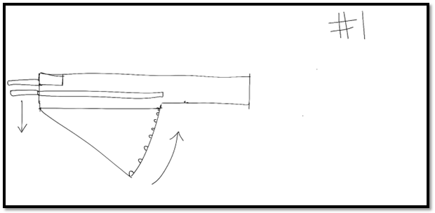
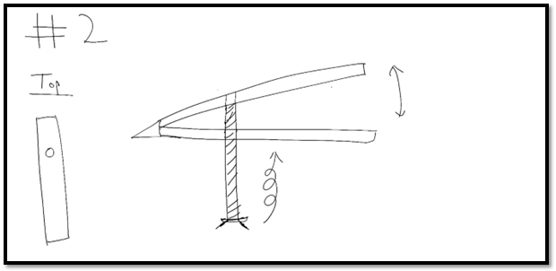
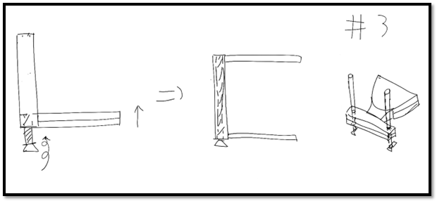
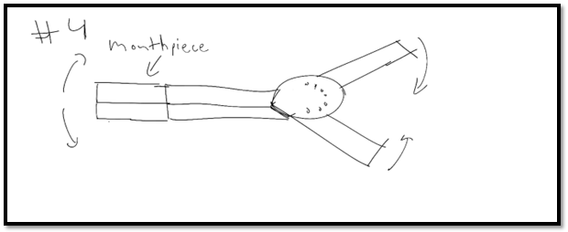
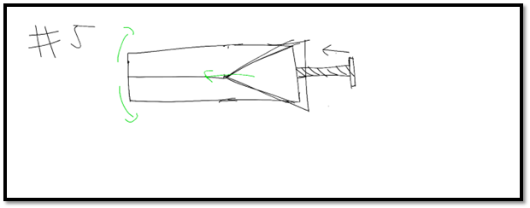
Concept Generation:
Mechanical Movement
Fig. 15 – Mechanical Systems
Nathan: 19

Slide 21
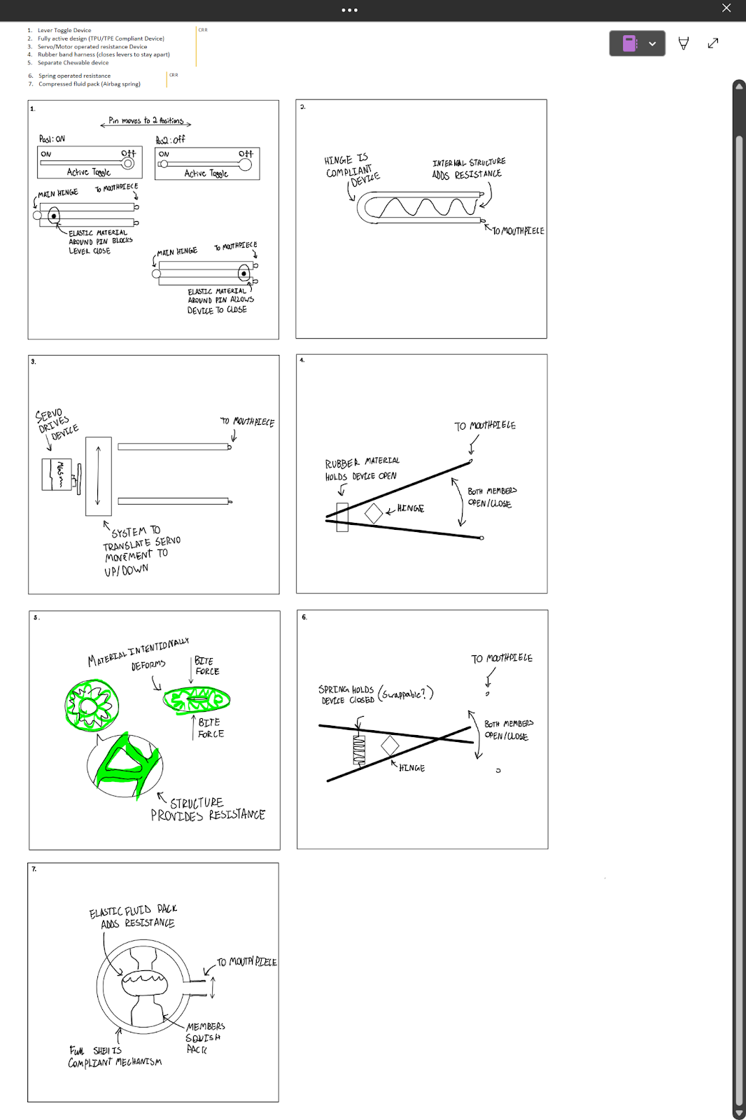
Concept Generation:
Compliant Springs
Fig. 16 – Active Resistance Systems
Carter: 20

Slide 22
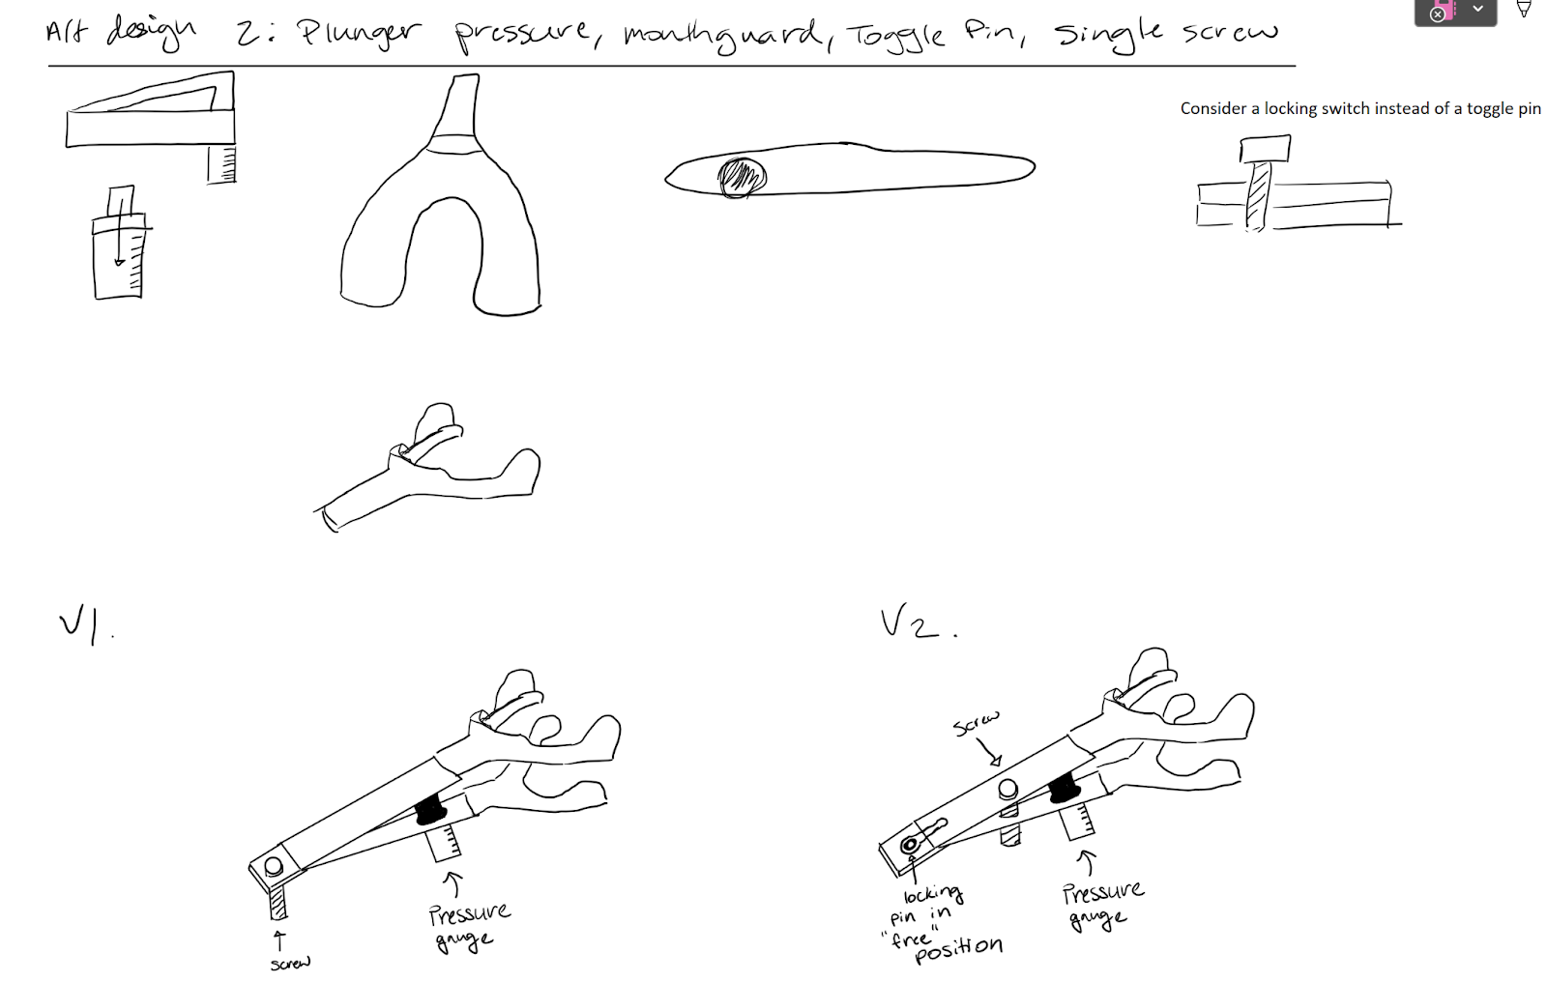
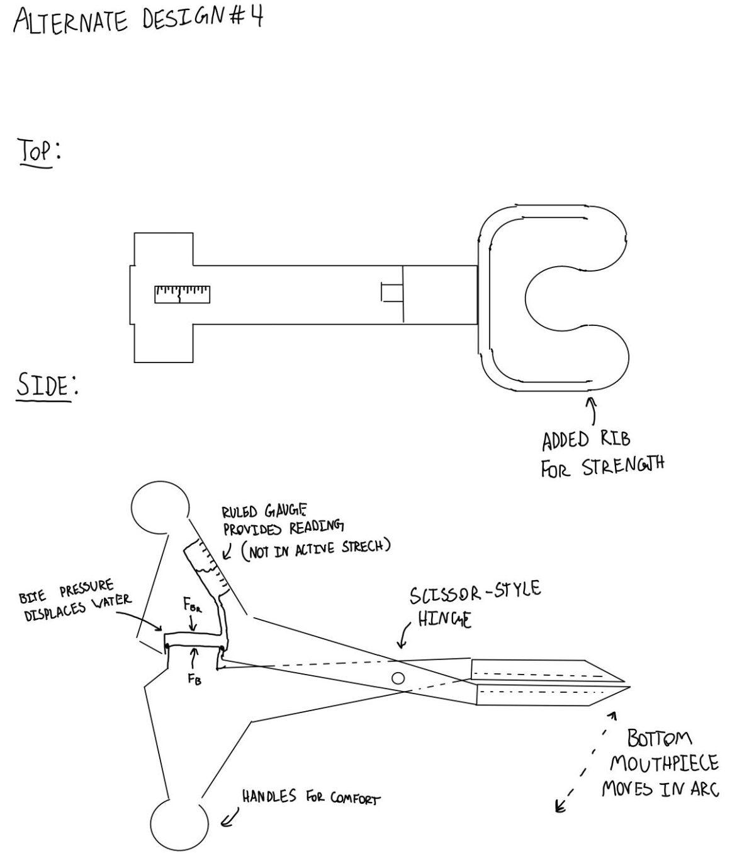
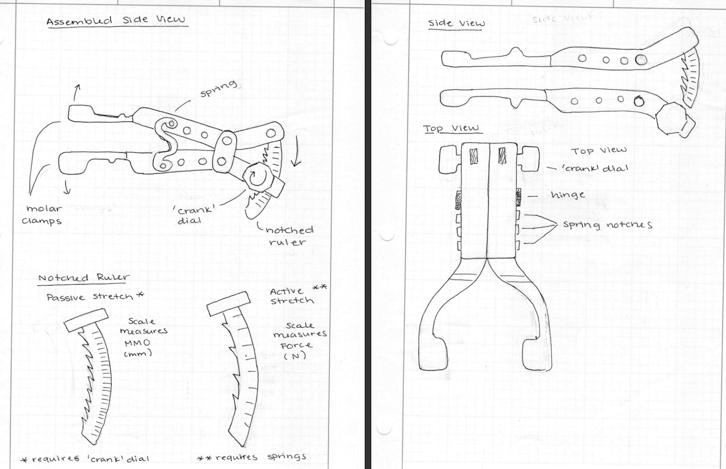
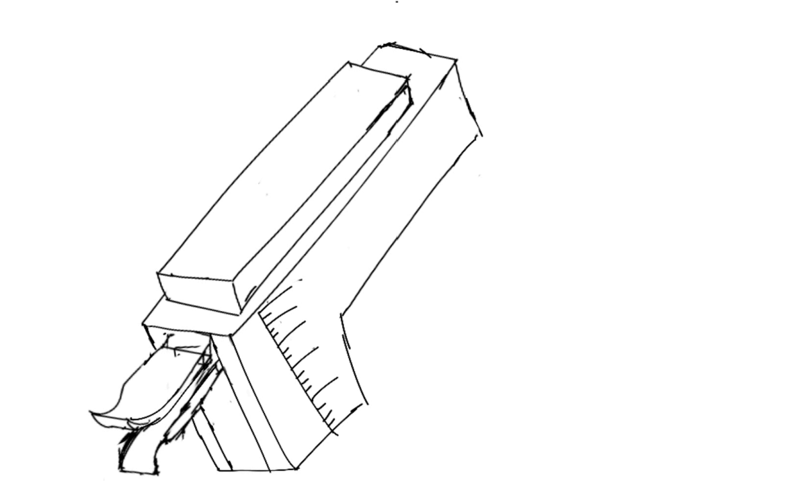
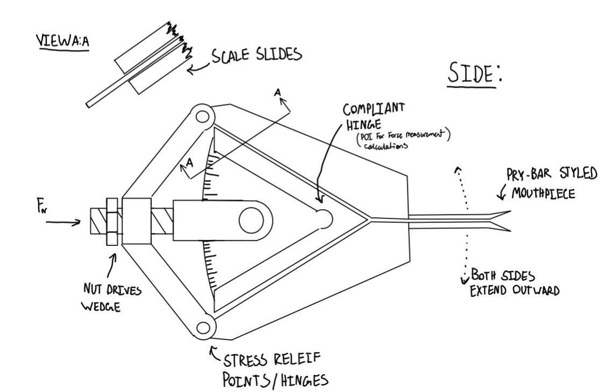
Alternative Designs
Fig. 20 – Alternative Design 4
Fig. 18 – Alternative Design 2
Fig. 19 – Alternative Design 3
Fig. 17 – Alternative Design 1
Fig. 21 – Alternative Design 5
Shilo: 21

Slide 23
Concept Evaluation
Fig. 22 – Alternative Design 2
Fig. 24 – Alternative Design 4
Fig. 23 – Alternative Design 3
Carter: 23

Slide 24
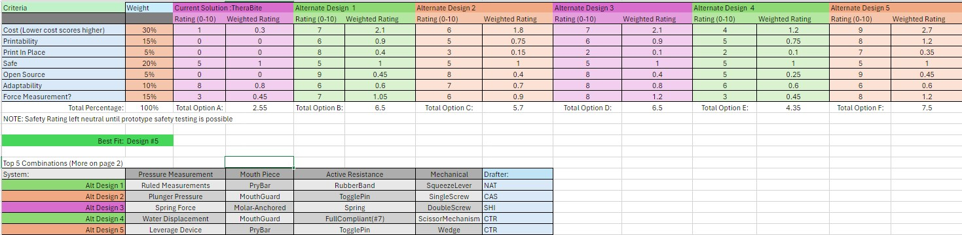
Concept Evaluation: Decision Matrix
Note: Safety Rating remains neutral until safety testing is possible
Table IV – Decision Matrix
Carter: 22

Slide 25
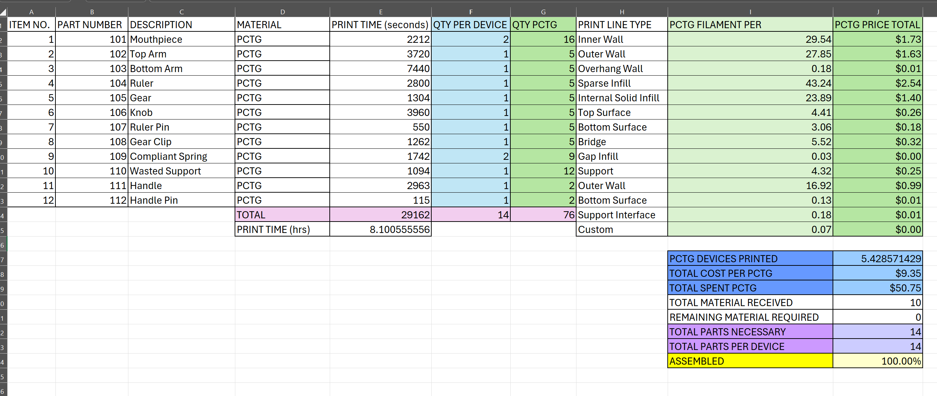
Bill of Materials
Table V: Bill of Materials
Cassina: 24

Slide 26
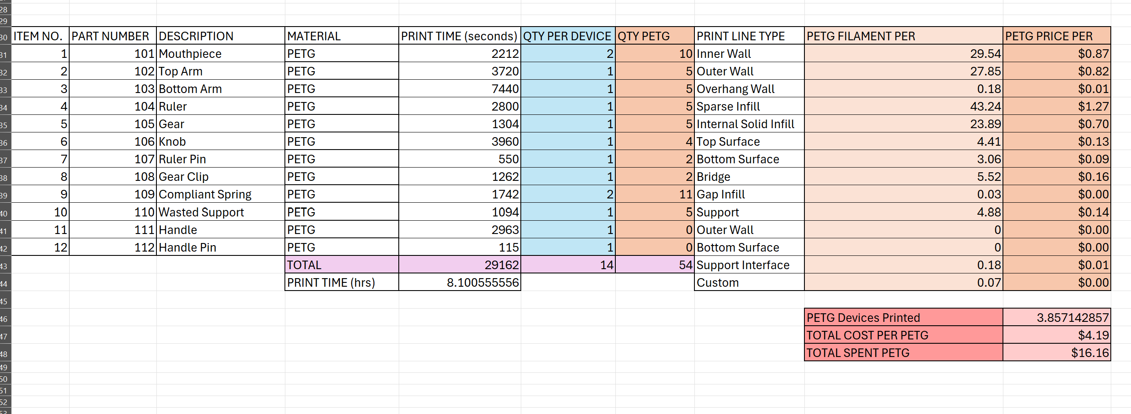
Bill of Materials
Table V: Bill of Materials
Cassina: 25

Slide 27
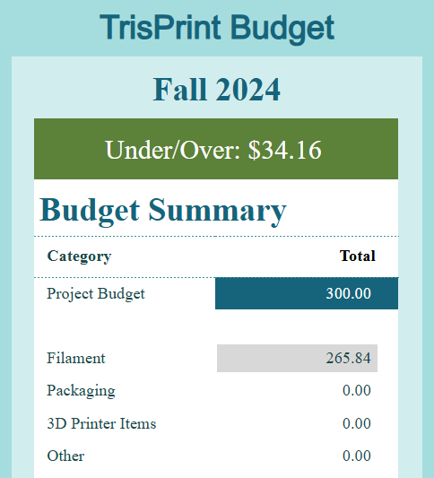
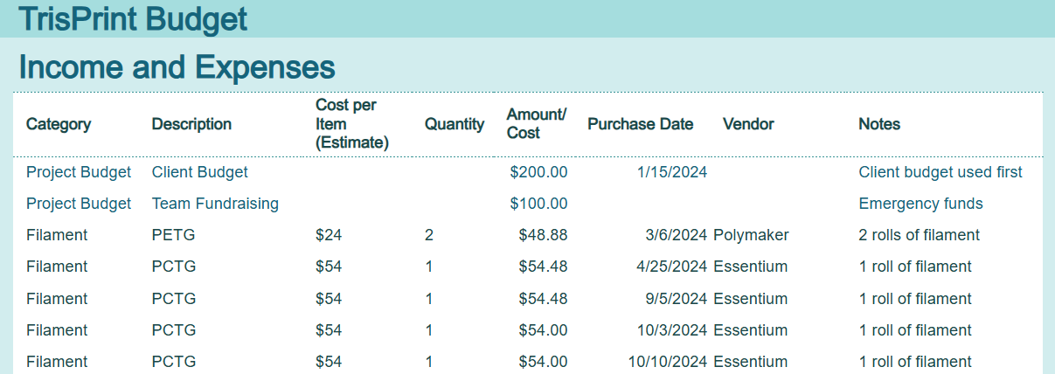
Budget
Main Expenses:
4 rolls of PCTG Filament
2 rolls of PETG Filament
Cost Per Device:
PCTG: $9.35
PETG: $4.19
Total Cost Printed:
PCTG: $50.75
PETG: $16.16
Table VII: TriPrint Budget Summary
Table VI: TrisPrint Budget Table
Shilo: 26

Slide 28
Schedule
Main Task:​ | Team Member(s):​ | Progress:​ | Target Completion Date:​
Hardware Status Update #3 (100%)​ | All​ | Complete​ | 11/6/24​
Final Poster and PowerPoint​ | All​ | On Time​ | 11/14/24​
Initial Testing Results​ | All​ | On Time​ | 11/21/24​
Final CAD Packet​ | All​ | On Time​ | 11/22/24​
Final Testing Results | All​ | On Time | 11/27/24​​
Final Report​ | All​ | On Time​ | 12/3/24​
Final Website Check​ | All​ | On Time​ | 12/4/24​
Final Product Demo and Assembly Manual​ | All​ | On Time​ | 12/5/2024​
Table VIII: Schedule Summary
Carter: 27

Slide 29
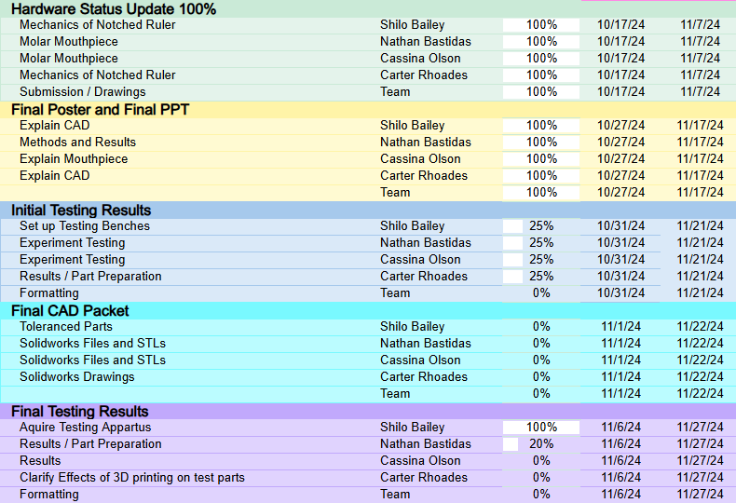
Gantt Chart
Table IX: Current Gantt Chart
Cassina: 28

Slide 30
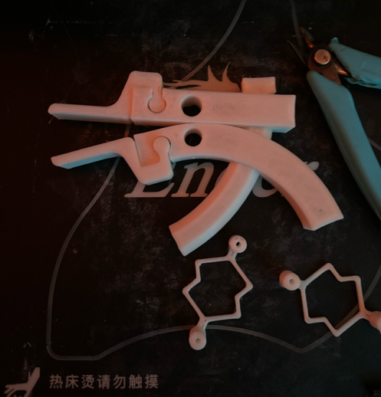
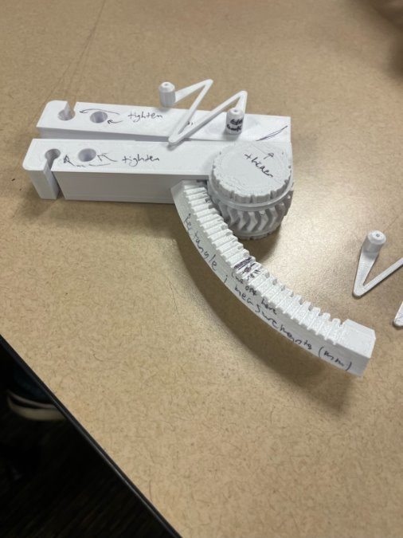
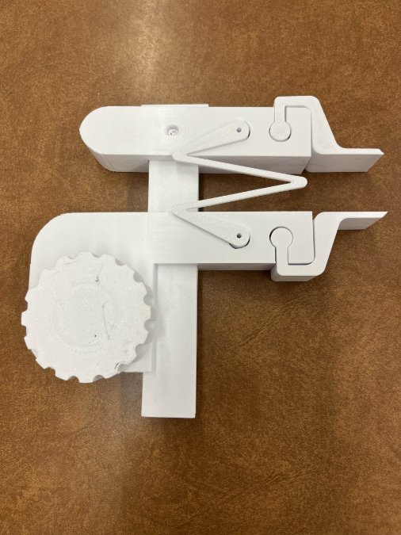
Design Validation & Prototyping
Fig. 25 – First Prototype
Fig. 26 – 2nd design iteration
Fig. 27 – 66% Build Prototype
Shilo: 29

Slide 31
Goal: Test motion of new ruled surface, full size prototype to determine ergonomics and usefulness of turn dial design.
Answer: Motion theoretically works well, print quality provides unwanted resistance / looseness to movement. New spring design deforms in a predictable way.
Design Consideration: The next version will have a straight arm for both the top and bottom members to increase printability, the next design will also include a larger turn dial for ease of grip. Via Client feedback, the mouthpieces will also be changed to be larger.
Goal: Ensure full functionality with tighter tolerancing and modified body shape based on team and client feedback.
Answer: The print, after some tolerancing, was consistently printing parts that are secure without compromising functionality.
Design Consideration: Include a printable handle and redesign gear and pinion track for opening function.
Goal: Ensure new clearances and motion within device are functioning correctly
Answer: The spring does not deform in a repeatable way or fit into the device, The ruled surface is oriented incorrectly, The Structure of the device appears stable
Design Consideration: The next Prototype will be properly scaled to fit/ Tolerances & Clearances
Nathan: 30

Slide 32
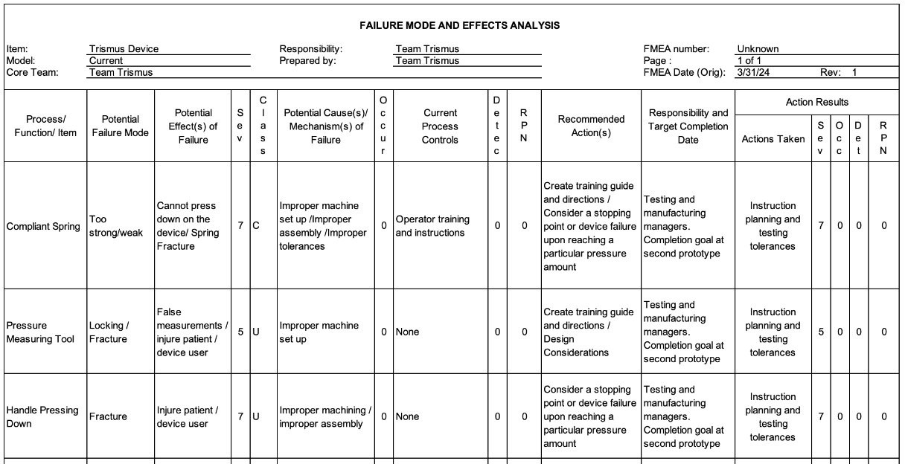
Table X: Failure Analysis Table
Cassina: 31

Slide 33
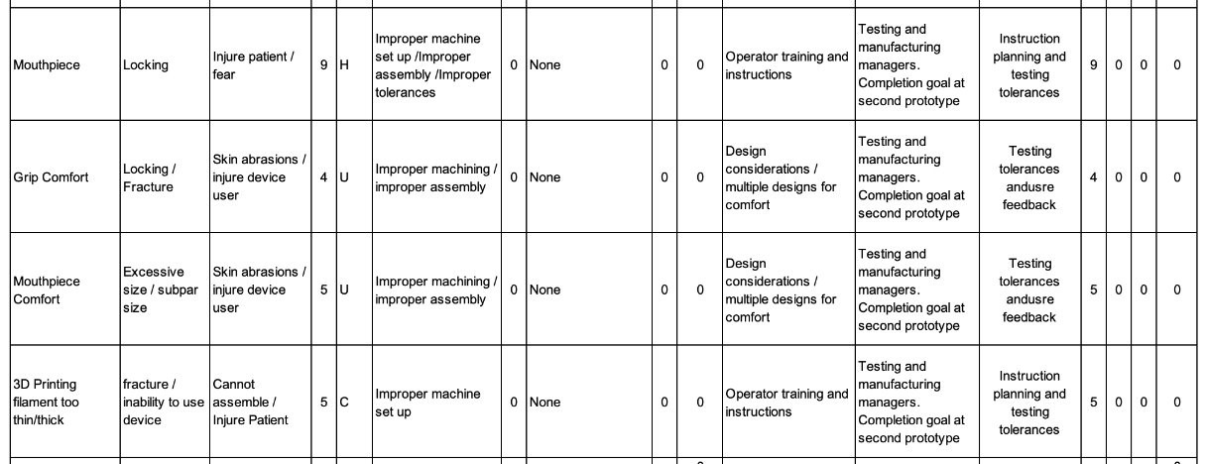
Table X: Failure Analysis Table
Cassina: 32

Slide 34
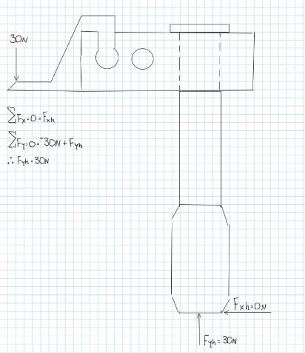
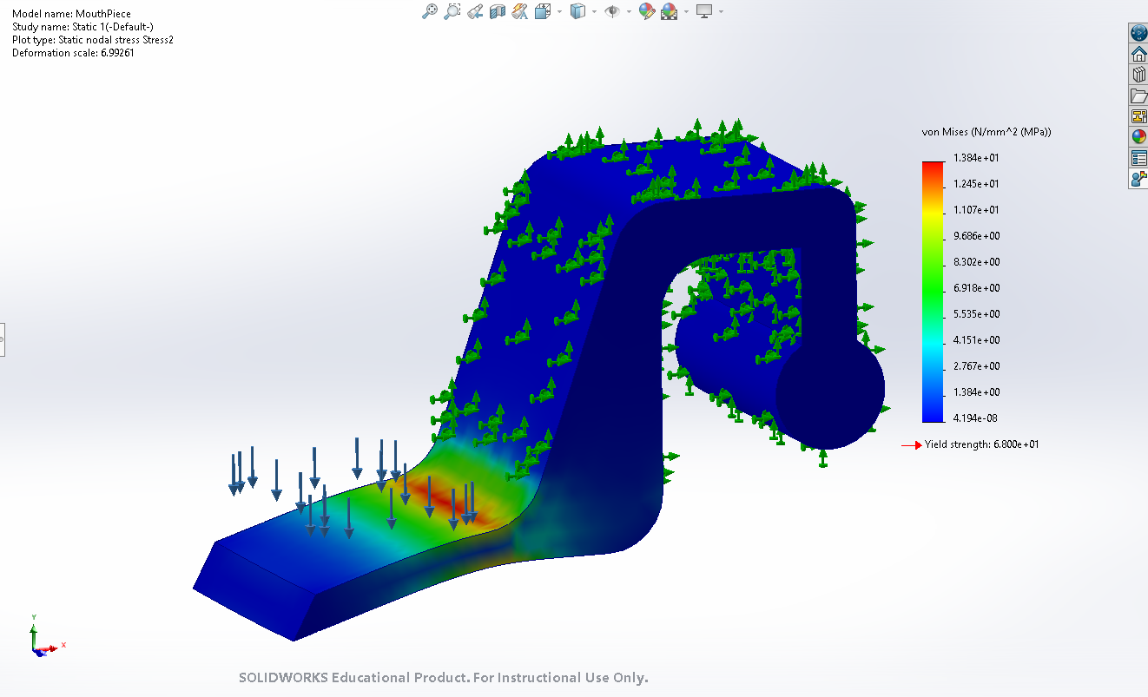
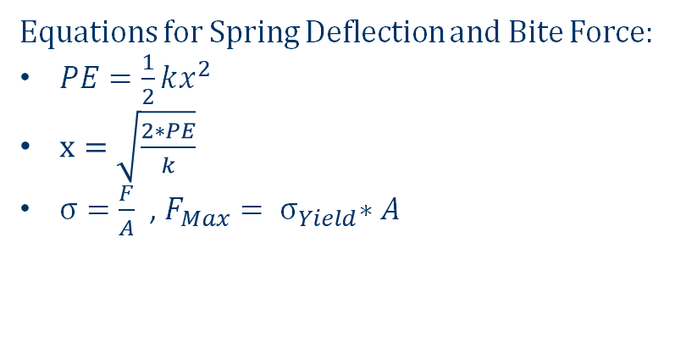
Engineering Calculations & Tools
Equations for Spring Deflection and Bite Force:
$PE=\frac{1}{2}kx^{2}$
$x=\sqrt{\frac{2∗PE}{k}}$
$σ=\frac{F}{A}$ , $F_{Max}{= σ}_{Yield}∗A$
Tools:
SolidWorks (Finite Element Analysis)
Bambu Lab Slicer (printing calibration)
Ultimaker Cura Slicer (printing calibration)
Fig. 28 – Mouthpiece Finite Element Analysis
Fig. 29 – Bite Force Free Body Diagram
Carter: 33

Slide 35
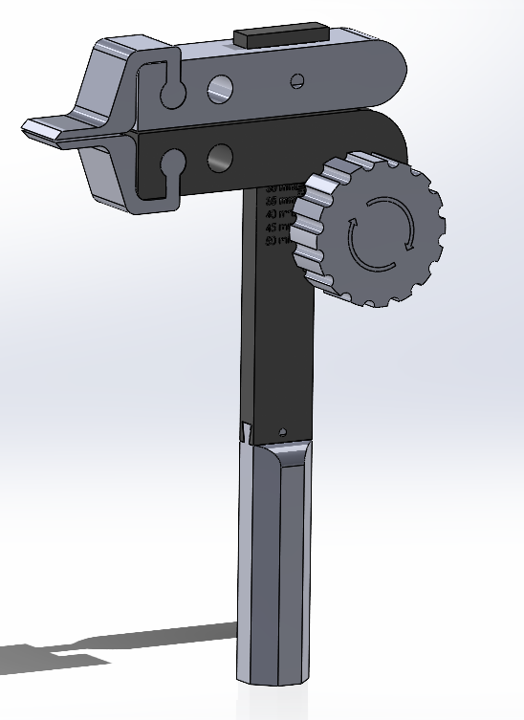
Final Hardware - CAD
Top Arm
Mouthpieces
Bottom Arm
Knob
Ruler
Handle
Fig. 30 – Current CAD
Nathan: 34

Slide 36
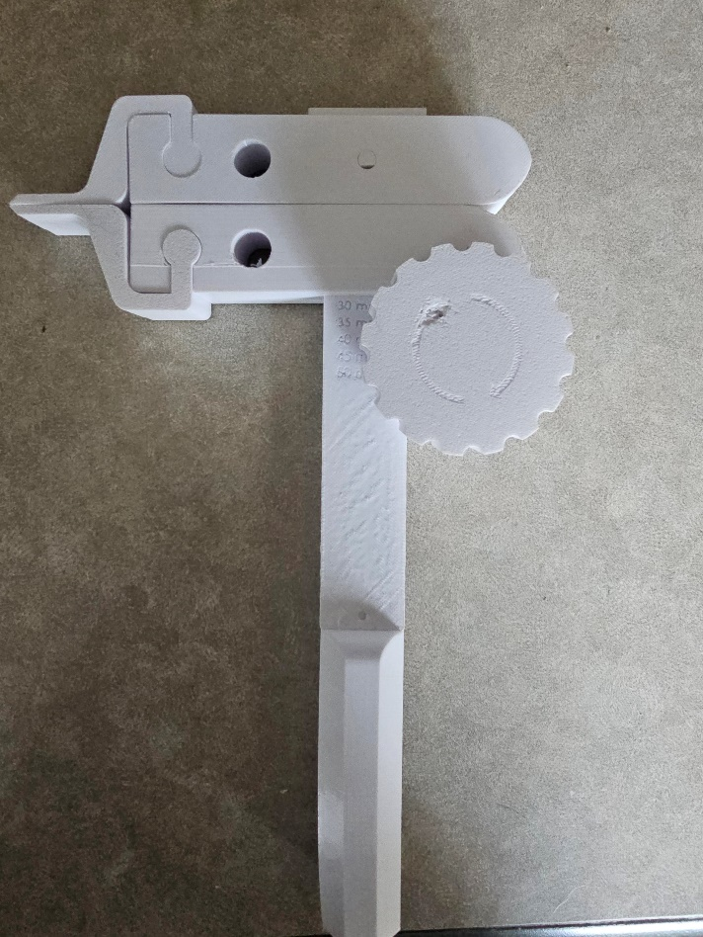
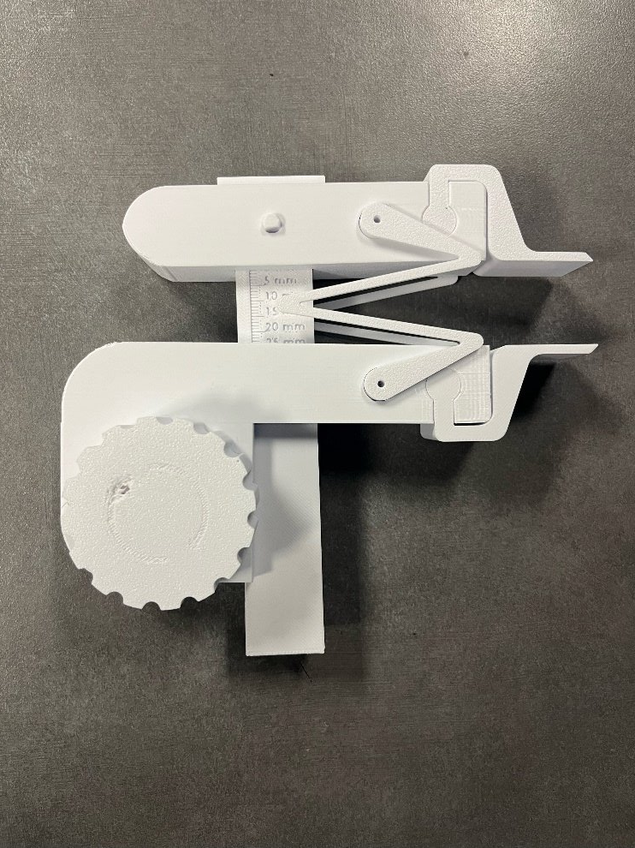
Progression to Final Iteration
Fig. 31 – Previous Iteration
Fig. 32 – Final Model
Shilo: 35

Slide 37
Final Testing Plan
Engineering Requirements | ER # | Customer Requirements | CR#
Ease of Printing | ER1 | Fully 3D Printable | CR1
Durable and Flexible | ER2 | Patient Safety Priority | CR2
Easily Reproducible | ER3 | Low Cost | CR3
Built In Measurement System | ER4 | Ability to Measure Progress | CR4
Experiment / Test | Relevant DRs
Ex1: Mouthpiece Bending Stress Point | ER2 , CR2
Ex2: Spring Failure Test | ER2 , CR2, CR4
Ex3: Gear Tooth Shear Test | ER2, CR2
Ex4: Printing Calibration Tests | ER1, CR1, ER3, CR3
Ex5: Measurement Calibration Tests | ER4, CR4
Table XII – Experiments With Associated Engineering / Customer Requirements
Table XI – Engineering and Customer Requirements
Carter: 36

Slide 38
Experiment # | Summary | Results
Ex1: Mouthpiece Bending Stress Point | The mouthpiece of the device will have a downward force of 60 N applied to the bridge to ensure the part fails by bending downwards. | Mouthpiece Failure : 55.4 N
Ex2: Spring Failure Test | The springs will be stretched out until failure to ensure breaking point via elongation is less than 5 N. | Spring Failure: 45.34 N
Ex3: Gear Tooth Shear Test | One tooth of the gear inside the device will have a downward force of 60 N applied to it to ensure the tooth shears at that force (measured in MPa). | Gear Tooth exceeds 60 N requirement
Ex4: Printing Calibration Tests | Two different commercial, entry level FDM printers (Creality’s Ender 3 and the Bambu Lab A1) will be used for test printing to ensure little to no modification to the printer or STL files is required to print and assemble the device. | Minor calibrations to file needed, no printer modification necessary.
Ex5: Measurement Calibration / Tolerance Tests | Multiple rulers of the device will be printed and be compared to other standard measurements devices (rulers, calipers, etc.) to ensure the spacing on the print is accurate within that +/- 0.5 mm tolerance. The compressive springs will be attached to a test bench to ensure each compression is equal to 5 N by measuring the deflection of the spring based on a certain amount of weight. | Tolerance for Ruler: +/- 0.39 mm Tolerance for Spring: +/- 0.15 N
Table XIII – Testing Summary and Results
Carter: 37

Slide 39
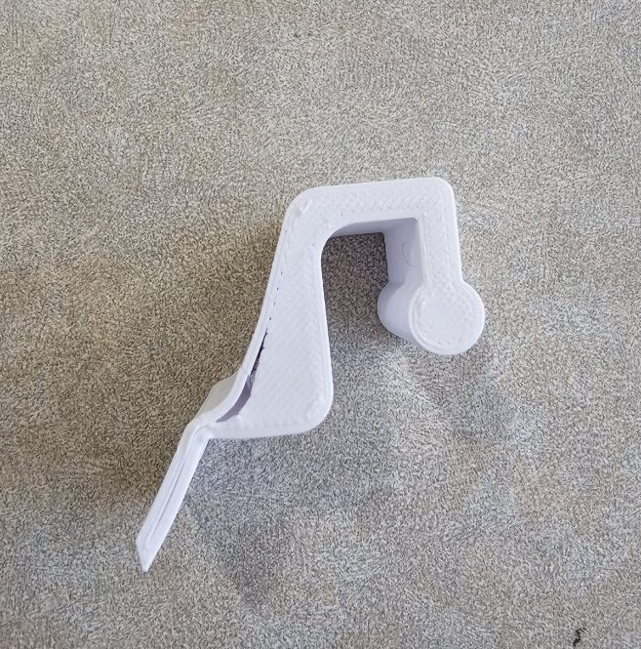
Customer Requirements | CR Met? (Y/N) | Client Acceptable? (Y/N)
Fully 3D Printable | Y | Y
Patient Safety Priority | Y | Y
Low Cost | Y | Y
Ability to Measure Progress | Y | Y
Engineering Requirements | Target | Tolerance | Measured/ Calculated Value | CR Met? (Y/N) | Client Acceptable? (Y/N)
Ease of Printing | 1 Print Job for entire device | N/A | N/A | Y | Y
Durable and Flexible | Mouthpiece: Failure within 60 N Spring: Failure within 5 N Gear Tooth: Failure within 60 N | Mouthpiece: +/- 5 N Spring: +/- 2 N Gear Tooth: +/- 5 N | Mouthpiece: 55.4 N Spring: 7 N Gear Tooth: - | Mouthpiece: Y Spring: Y Gear Tooth: N | Y
Easily Reproducible | Tested between multiple FDM printers, no issues regarding functionality or tolerances | Tolerancing: +/- 0.5 mm Functionality: Fully functional with no slippage or alignment issues | N/A | Y | Y
Built In Measurement System | Ensure accurate measurement for built in ruler and spring compressions. | Tolerance for Ruler: +/- 0.5 mm Tolerance for compression: +/- 0.5 N | Ruler: +/- 0.39m Spring: +/- 0.15 N | Y | Y
Tables XIV & XV – Customer Requirements Status (Left) and Engineering Requirements Status (Right)
Fig. 33 - Mouthpiece After Failure
Carter: 38

Slide 40
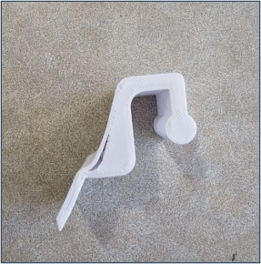
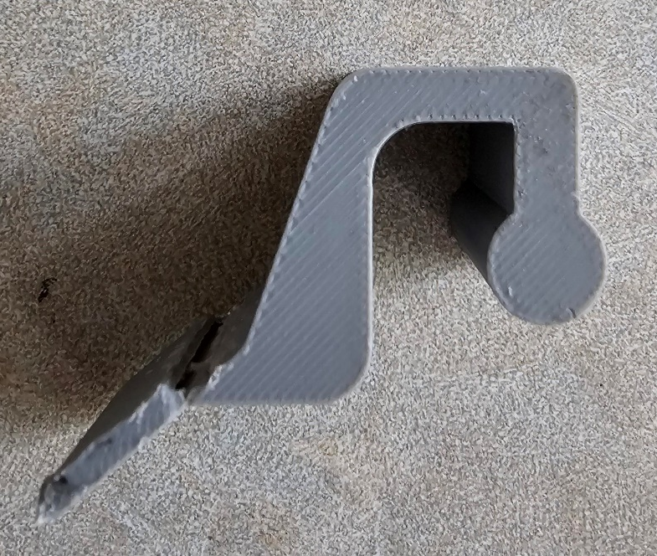
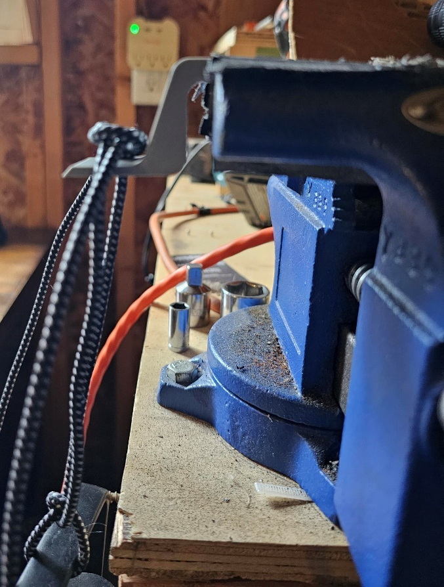
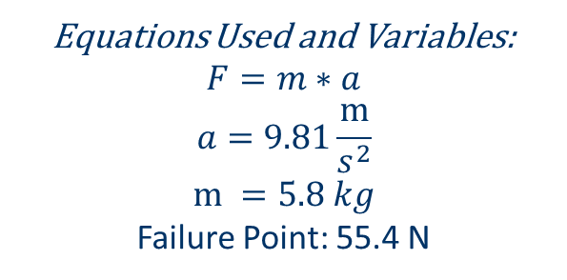
Ex.1: Mouthpiece Bending Results
Fig. I – Mouthpieces After Failure
Equations Used and Variables:
$$F=m∗a$$
$$a=9.81\frac{m}{s^{2}}$$
$$m =5.8 kg$$
Failure Point: 55.4 N
Fig. II – Mouthpieces Test
Nathan: 39

Slide 41
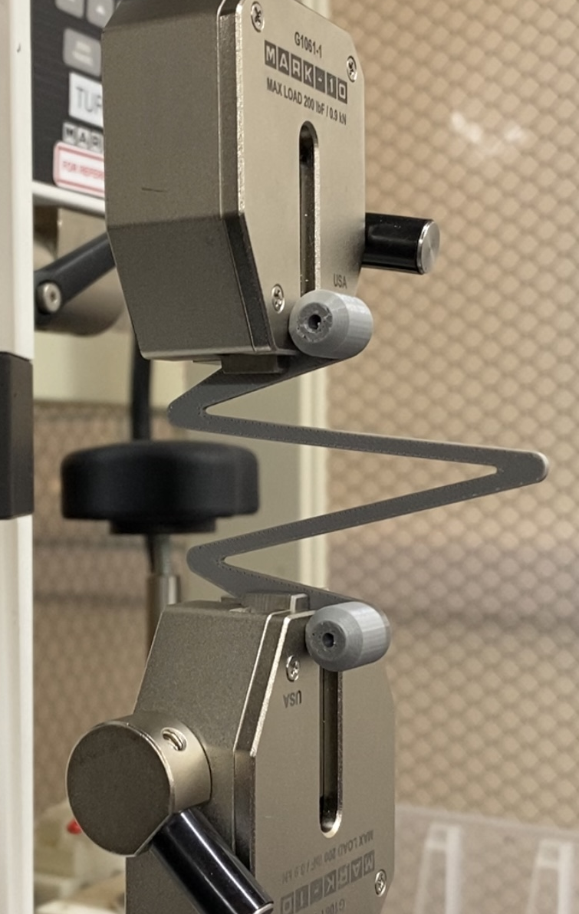
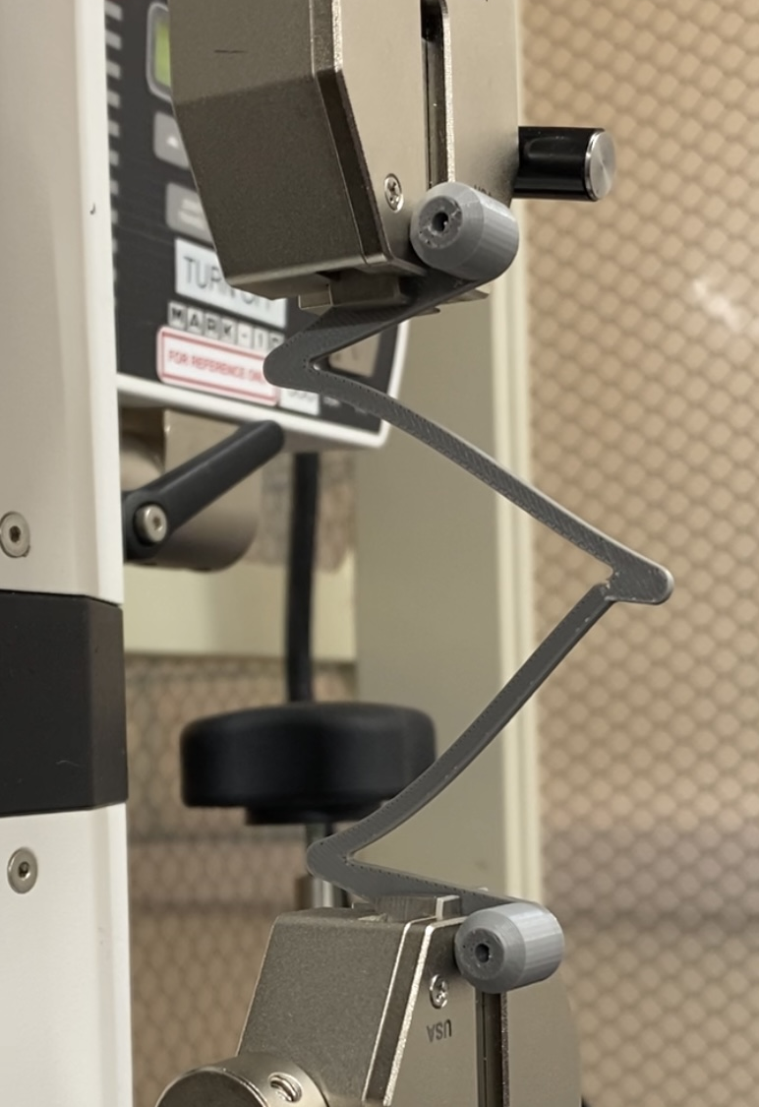

Ex.2: Spring Elongation Testing
Fig. III – Spring Elongation Procedure (Static to Failure)
Shilo: 40

Slide 42

Spring Elongation Results
Spring Elongation Testing
Sample | Force (N)
1 | 7.3
2 | 6.2
3 | 7.2
4 | 7.3
5 | 7
6 | 7.2
7 | 7
Table X – Spring Elongation Failure Loads
Fig. IV – Spring Elongation Test (Sample 1)
Shilo: 41

Slide 43

Spring Elongation Results
Spring Elongation Testing
Sample | Force (N)
1 | 7.3
2 | 6.2
3 | 7.2
4 | 7.3
5 | 7
6 | 7.2
7 | 7
Table X – Spring Elongation Failure Loads
Fig. V – Spring Elongation Test (Samples 2-7)
Shilo: 42

Slide 44

Ex.3: Gear Shear Test
XY Ultimate Tensile Stress from Horizontal Print: 33.15 MPa
Fig. VII – Gear Shear Calculations
Cassina: 43

Slide 45


Ex.4: Printing Calibration Testing
Fig. VIII – Successful Print Layer
Fig. IX – Failed Print Layer
Carter: 44

Slide 46


Ex.5: Measurement Testing - Ruler
Fig. X – Concomitant Measuring Results
Results:
Ruler Measurement: 5 mm
Caliper Measurement: 4.61-4.68 mm
Error: 0.32-0.39 mm or ~8.45%
Nathan: 45

Slide 47


Ex.5: Measurement Testing - Spring
Equations and Variables:
$$F=m∗a$$
$$a=9.81\frac{m}{s^{2}}$$
$$m=0.5 kg=1.16 lbs$$
Total Calculated Applied Force: 5 N
Actual Applied Force: 5.15 N
Error: 0.15 N or 2.91%
Fig. XI – Spring Compression Measuring Results
Nathan: 46

Slide 48


Additional Test: Material Tensile Test
Fig. XII – Creality Print Orientation Setup
Fig. XI – Vertical Material Test Results
Shilo: 47

Slide 49

Additional Test: Material Tensile Test
Fig. XII – Creality Print Orientation Setup
Fig. XIII – Horizontal Material Test Results
Shilo: 48

Slide 50

Additional Test: Model Skull
Assumptions:
Force Applied By Each Set of Bands: 8 N
# of Sets Needed to Simulate Patient: ~7.5 Sets
Maximum Sets Used: 7 Sets
Maximum Force Applied: 58 N
Fig. XIV – Model Skull Test / Demonstration
Cassina: 49

Slide 51
Future Work
Next Steps:
Clinical Trials
    Approval for testing has been submitted
    Feedback from patients will help improve design and functionality
Fig. 1 - Science Direct V16 I1 doi.org
Nathan: 50

Slide 52
Thank you!
Questions?

Slide 53
References:
[1] Nina Pauli, Ulrika Svensson, Therese Karlsson & Caterina Finizia (2016) “Exercise intervention for the treatment of trismus in head and neck cancer – a prospective two-year follow-up study,” Acta Oncologica, 55:6, 686-692, DOI: 10.3109/0284186X.2015.1133928
[2] Charters E, Dunn M, Cheng K, Aung V, Mukherjee P, Froggatt C, Dusseldorp JR, Clark JR, “Trismus therapy devices: A systematic review,” Oral Oncology, Volume 126, 2022, 105728, ISSN 1368-8375, https://doi.org/10.1016/j.oraloncology.2022.105728. Accessed February 3, 2024
[3] Daniel Buchbinder, Robert B. Currivan, Andrew J. Kaplan, Mark L. Urken, “Mobilization regimens for the prevention of jaw hypomobility in the radiated patient: A comparison of three techniques,” Journal of Oral and Maxillofacial Surgery, Volume 51, Issue 8, 1993, Pages 863-867, ISSN 0278-2391, https://doi.org/10.1016/S0278-2391(10)80104-1.
[4] Emma Charters, Jamie Loy, Raymond Wu, Kai Cheng, Masako Dunn, Sarah Davies, Jonathan Clark, “Feasibility study of intensive intervention using novel trismus device during adjuvant radiation for head and neck cancer: RestorabiteTM,” Oral Oncology, Volume 146, 2023, 106558, ISSN 1368-8375, https://doi.org/10.1016/j.oraloncology.2023.106558. ‌
[5] W. R. Wagner and B. D. Ratner, Biomaterials Science: An Introduction to Materials in Medicine. San Diego, CA: Academic Press, 2020.
[6] J. B. Park and R. S. Lakes, Biomaterials: An Introduction. New York, NY: Springer, 2010.
[7] D. Dharavath and R. Maddi, “ISO standards of Medical Devices,” World Journal of Current Medical and Pharmaceutical Research, https://wjcmpr.com/index.php/journal/article/view/213 (accessed Feb. 4, 2024).
[8] M. Jeong et al., “Materials and applications of 3D printing technology in Dentistry: An overview,” MDPI, https://www.mdpi.com/2304-6767/12/1/1 (accessed Feb. 4, 2024).
[9] M. Guvendiren, J. Molde, R. Soares, and J. Kohn, “Designing biomaterials for 3D printing - ACS Publications,” ACS Publications, https://pubs.acs.org/doi/abs/10.1021/ACSBIOMATERIALS.6B00121 (accessed Feb. 5, 2024).
[10] “Biocompatible 3D resins for medical devices,” 3Dresyns, https://www.3dresyns.com/pages/bio-compatible-3dresyns (accessed Feb. 4, 2024).
[11] “Siraya Tech Blu-tough resin,” Siraya Tech, https://siraya.tech/products/blu-tough-resin-by-siraya (accessed Feb. 4, 2024).
[12] J. P. Davim, The design and manufacture of medical devices. Ch 1. Cambridge: Woodhead Publishing Ltd, 2012.
[13] D. van Gijn, et al. 'Ch.2: The mandible', Oxford Handbook of Head and Neck Anatomy, Oxford Medical Handbook e-pub, Jan. 2022.
[14] Y. Ihara et al., “The Device of Ethylene Vinyl Acetate Sheet for Trismus Caused by Bilateral Mandible Fractures,” Case Reports in Dentistry, vol. 2021, pp. 1–6, Aug. 2021, doi: https://doi.org/10.1155/2021/8340485.
[15] Center for Devices and Radiological Health, “Classify Your Medical Device,” U.S. Food and Drug Administration, Jul. 02, 2020. https://www.fda.gov/medical-devices/overview-device-regulation/classify-your-medical-device
‌[16] P. U. Dijkstra, W. W. I. Kalk, and J. L. N. Roodenburg, “Trismus in head and neck oncology: a systematic review,” Oral Oncology, vol. 40, no. 9, pp. 879–889, Oct. 2004, doi: https://doi.org/10.1016/j.oraloncology.2004.04.003.
  This paper shows the effects of radiation on certain muscle groups and joints in the mandibular area.
[17] M. Louise Kent et al., “Radiation-Induced trismus in head and neck cancer patients,” Supportive Care in Cancer, vol. 16, no. 3, pp. 305–309, Oct. 2007, doi: https://doi.org/10.1007/s00520-007-0345-5.
[18] C.-J. Wang, E.-Y. Huang, H.-C. Hsu, H.-C. Chen, F.-M. Fang, and C.-Y. Hsiung, “The Degree and Time-Course Assessment of Radiation-Induced Trismus Occurring After Radiotherapy for Nasopharyngeal Cancer,” The Laryngoscope, vol. 115, no. 8, pp. 1458–1460, Aug. 2005, doi: https://doi.org/10.1097/01.mlg.0000171019.80351.46.
[19] O. Isman, “Evaluation of jaw bone density and morphology in bruxers using panoramic radiography,” Journal of Dental Sciences, Oct. 2020, doi: https://doi.org/10.1016/j.jds.2020.09.008.
[20] J. Lee and A. Huang, “Fatigue Analysis of FDM Materials,” Rapid Prototyping Journal, vol. 19, no. 4, pp. 291–299, Jun. 2013. doi:10.1108/13552541311323290
[21] C. Guttridge, A. Shannon, A. O’Sullivan, K. J. O’Sullivan, and L. W. O’Sullivan, “Biocompatible 3D printing resins for medical applications: A review of marketed intended use, biocompatibility certification, and post-processing guidance,” Annals of 3D Printed Medicine, vol. 5, p. 100044, Mar. 2022. doi:10.1016/j.stlm.2021.100044
[22] L. Novakova-Marcincinova, J. Novak-Marcincin, J. Barna, and J. Torok, “Special materials used in FDM Rapid Prototyping Technology Application,” 2012 IEEE 16th International Conference on Intelligent Engineering Systems (INES), Jun. 2012. doi:10.1109/ines.2012.6249805

